Slide 1

Slide 1
Loan defaulter prediction
A data driven approach to spot out the defaulters
Done by
Roger Arnold H

Slide 2
Table of contents
Need for this case study
Univariate analysis
Insights obtained form Univariate analysis
Bivariate analysis
Insights obtained form Univariate analysis
Prediction Constraints
Prediction accuracy
Conclusion

Slide 3
Need for this case study ?
There are several lenders who face loss avoiding to understand risky applicants . So , it will be very much helpful for both the lender and borrower to save their money instead to waste it after years. Our aim in this case study is to apply data driven decisions for predicting a loan defaulter

Slide 4
Slide 1
Univariate Analysis
Analyzing single variable to obtain insights

Slide 5


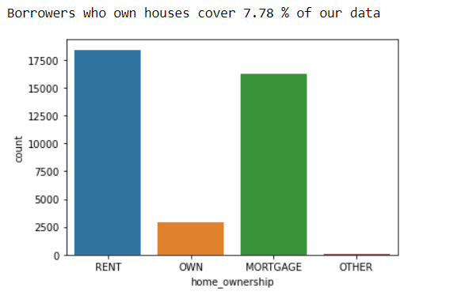
Slide 7
35
25
7.78%
This shows that the major need for money is maximum for the borrowers who rent or mortgage houses.
Your logo

Slide 6
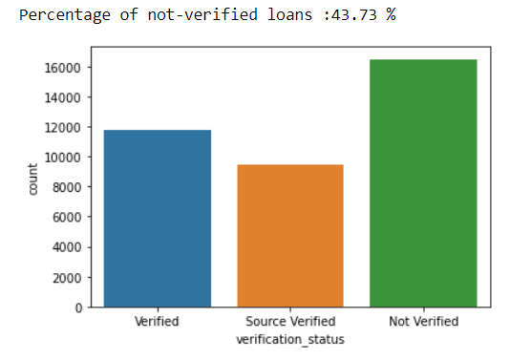
Slide 7
44%
Record shows that round 44% of loan lenders are not verifying the borrowers source of income
Your logo

Slide 7
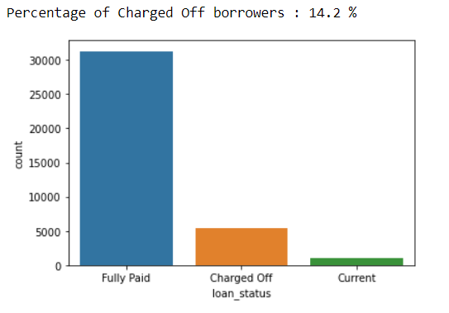
Slide 7
14.2%
43
Charged Off Borrowers make up 14% of our data
Your logo

Slide 8
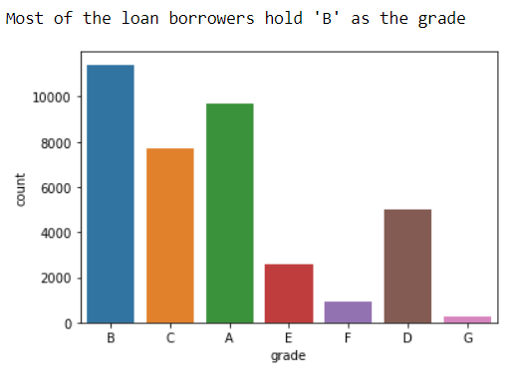
Slide 7
43
Majority of the loan borrowers have “B” as the loan grade
Your logo

Slide 9

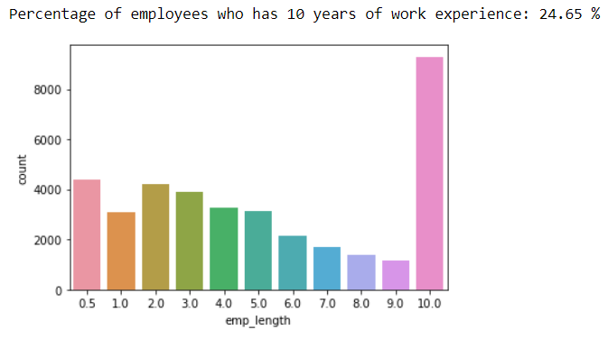
Slide 7
25%
43
Most of the working professionals who has 10 years of professional experience show more interest to borrow loans than the others
Your logo

Slide 10
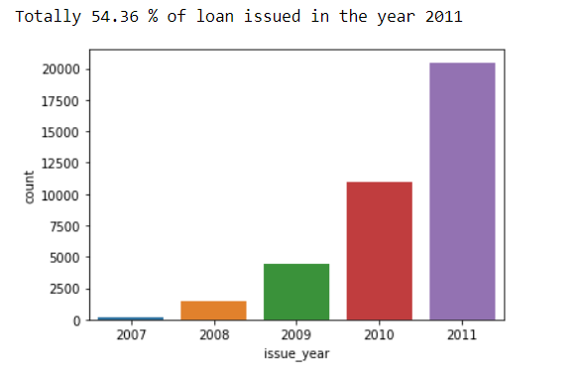
Slide 7
54%
43
More number of loan was issued in the year 2011. Nearly 54% lending is recorded. US Debt Ceiling Crisis is the main reason for this loan records . It affected markets till Dec 2012.
Your logo

Slide 11
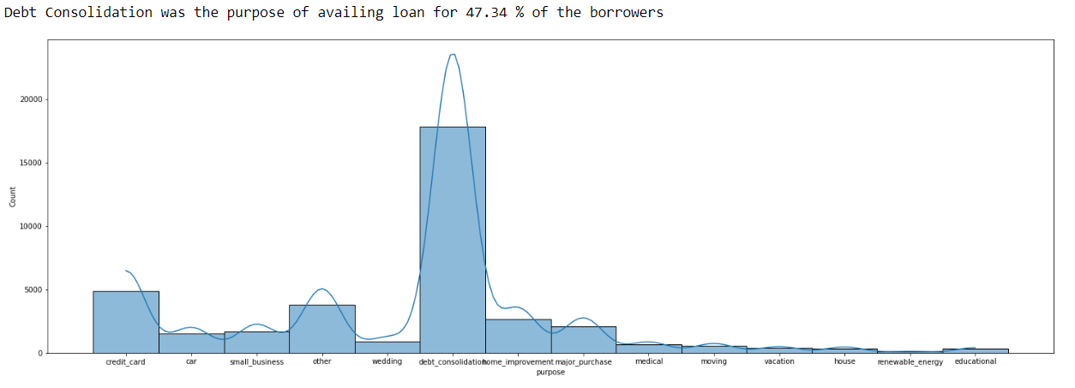
Slide 7
47%
Debt consolidation
43
About 47.34% of borrowers avail loan for debt consolidation as their major purpose
Your logo

Slide 12
Debt Consolidation as the major purpose

Slide 13
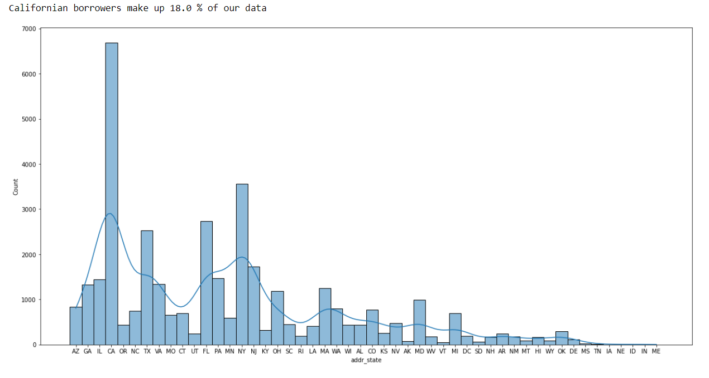
Slide 7
California shows good strength of loan borrowers all time

Slide 14
Univariate Insights:
Majority of the loan borrowers either rent the house or mortgage it. Own house loan borrowers are very few
44% of the borrowers income source is not verified
Debt consolidation is the major purpose for availing loans . 47.34% of borrowers loans for this specific reason
California shows the highest record of loan borrowers. Around 17.74% of total borrowers are from California. Which in turn gives us 3% of total charged off borrowers from this very same state
Charged Off borrower's make up 14% of our data.
24.65% of the borrowers have 10 years of work experience.
54.36% of loan issues happened in the year of 2011

Slide 15
Slide 1
Bivariate Analysis
Analyzing double variables to obtain insights

Slide 16
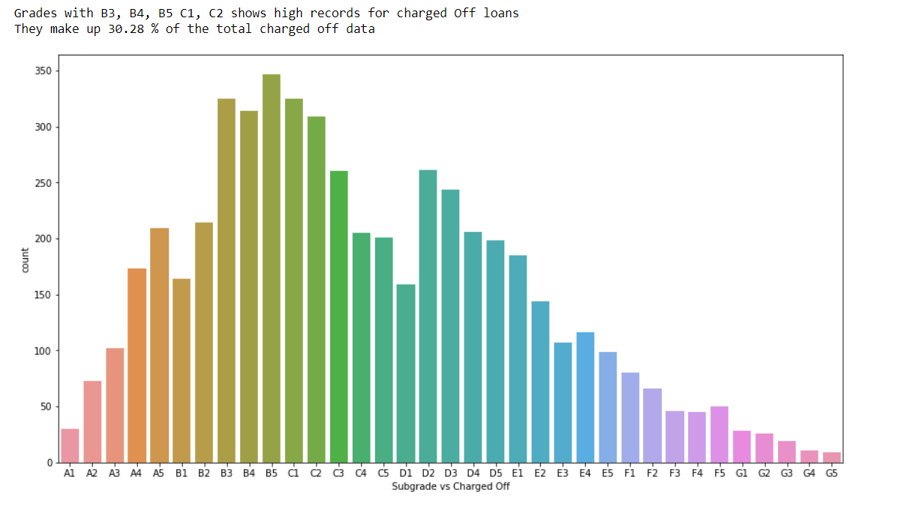
Behavior of sub grades in charged off borrowers

Slide 17
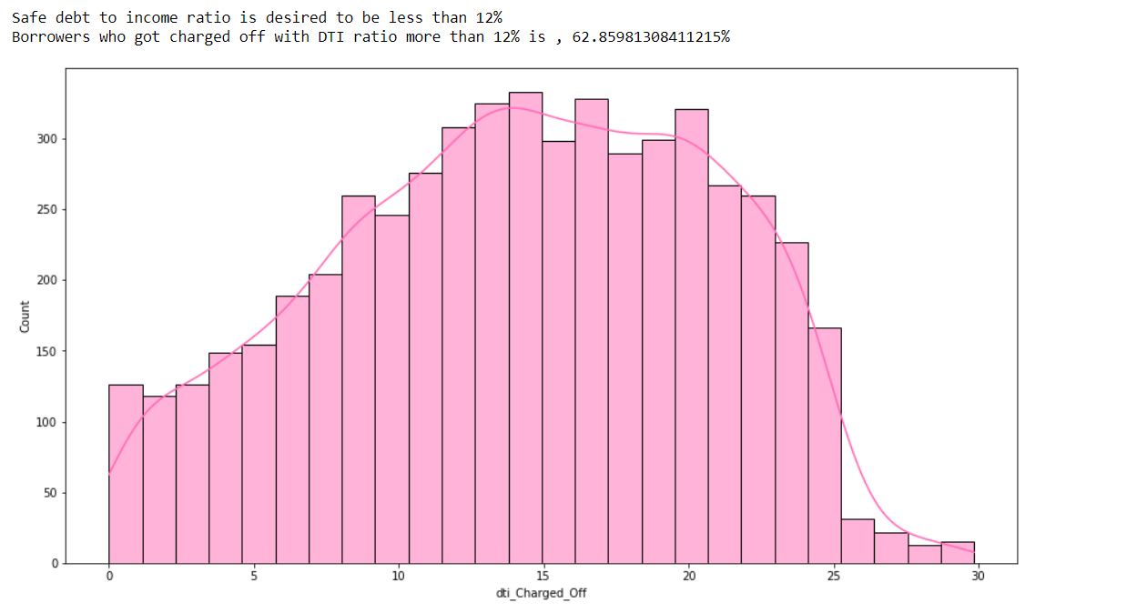
Behavior of Debt to income ratio with charged Off Borrowers

Slide 18
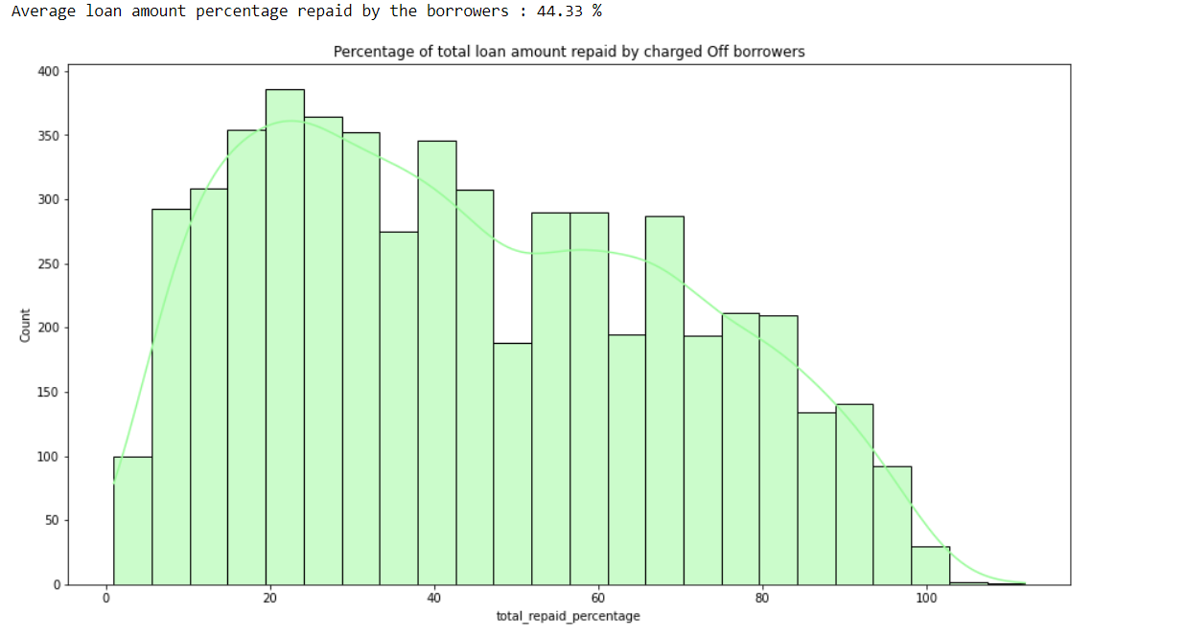
Total amount repaid by charged Off borrowers

Slide 19
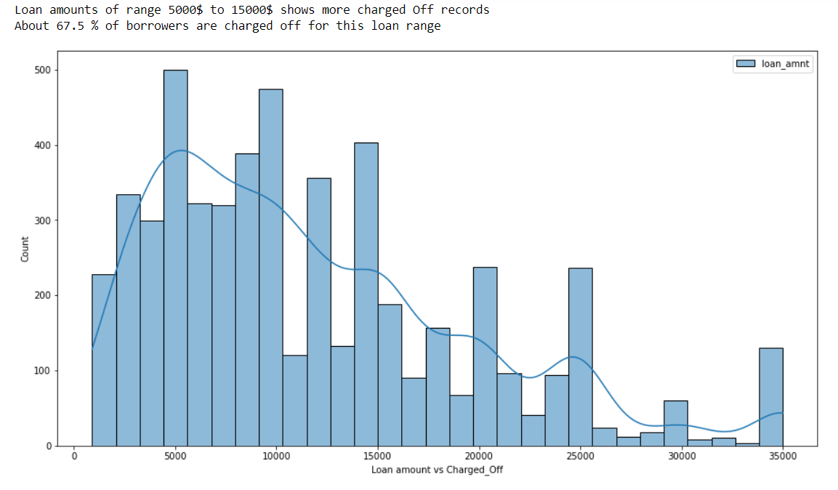
Charged Off loan amounts

Slide 20
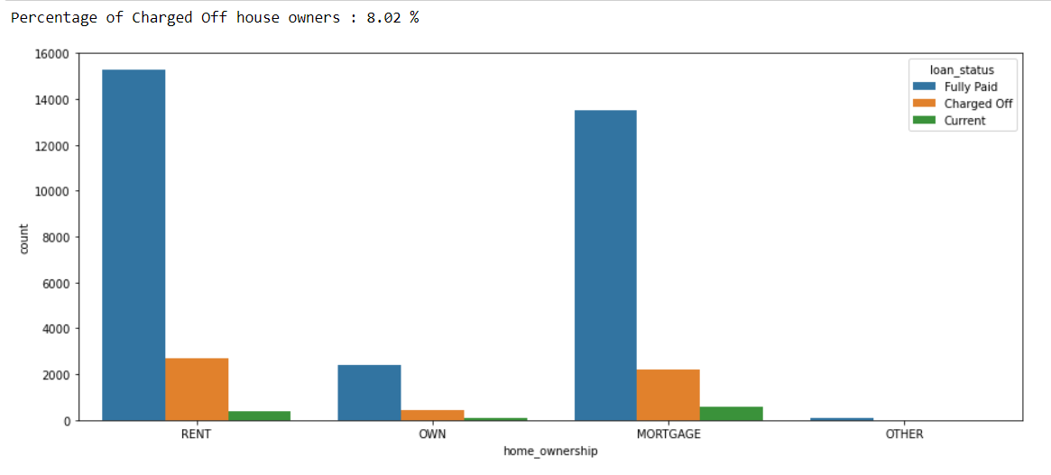
House owners are very less likely to get charged Off

Slide 21
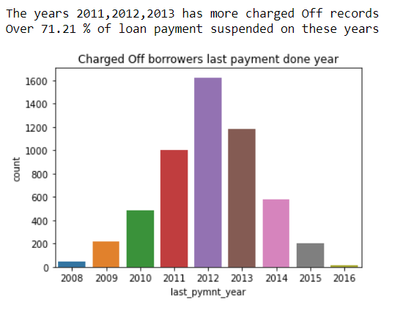
Years which has maximum number of Charged Off records

Slide 22
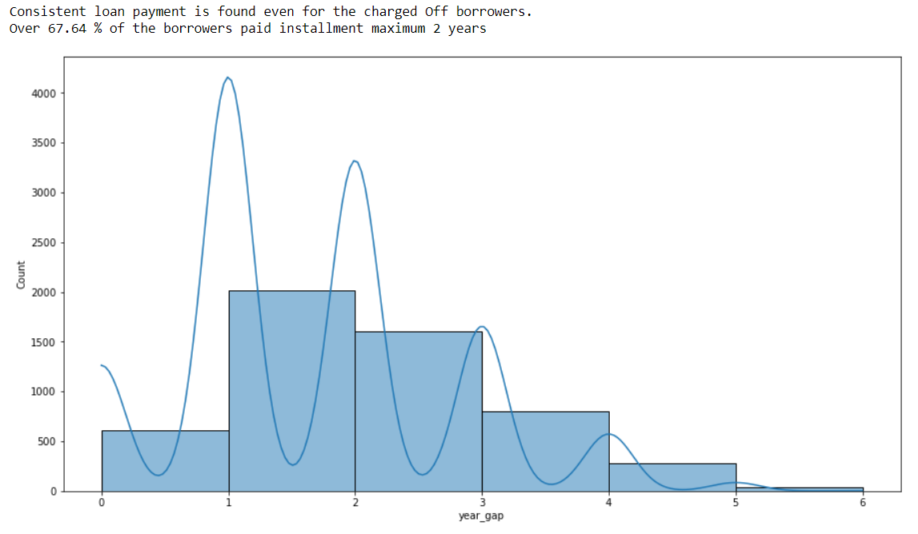
Loan payment consistency

Slide 23
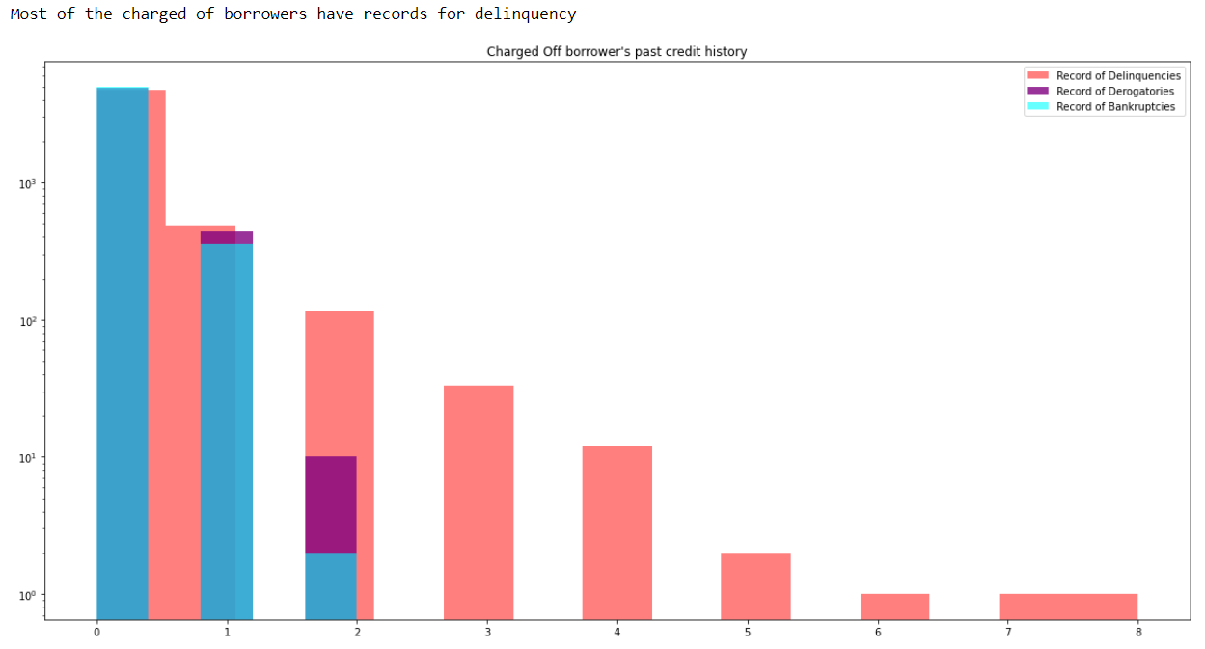
This shows charged Off borrowers past credit history

Slide 24
Bivariate Insights
30.28% of the charged off borrowers belong to these grades : B3,B4,B5,C1,C2
62.86% of the charged off borrowers has dti more than 12
On average, Charged Off borrowers repay 44.32% of the total amount
Percentage of house owners charged Off = 8.01%
Percentage of Charged Off borrowers with Not verified income sources = 38.50%
Average loan amount lent for charged off borrowers is 11,800 . About 67% of charge Off happened for the loan amount in the range of 5000 to 15000
The years 2011 to 2013 has the most number of charged off records . About 71.2% of charge offs happened in these years
If we analyze the loan commitment duration, the data shows that 67.64% of borrowers are charged off within first 2 years of tenure
It's hard to predict the loan defaulter using these parameters , "open_acc" , "revol_util" , "addr_state" . Their distribution varies uniformly throughout the data
Most of the charged Off borrowers have records of delinquency

Slide 25
Slide 1
Major driving variables
Variables that are closely associated with charged Off borrowers

Slide 26
Major Driving Variables associated closely with loan defaulter
Debt to income ratio
Home ownership
Income source verification status of a borrower
Total number of years borrower paid installment
Total percentage of amount repaid
Sub grade of a borrower
Records of delinquency

Slide 27
Slide 1
Prediction Constraints
Number of checks lenders need to validate before issuing loan

Slide 28
Checks we need to carry out to predict a loan defaulter.
House owners are the safest borrowers. Lenders can be confident on them.
dti ratio should be less than 12
Bankers should critically monitor all borrowers once they paid 40% of total payment . Chances of defaulters are more after the paid this ratio of amount
B3, B4, B5, C1, C2 grade borrowers are more likely to default.
It's not a good idea to lend money without verifying borrower's income source. So bankers need to eliminate this activity completely
The high risky loan amounts which are more likely to default is mostly in the range of 5000$ to 15000$
Lenders cannot predict the defaulter within the first year. So it's always good to monitor due date and payment consistency after a year from loan issue
There should not be any records of delinquency. As this pattern is more likely to be repeated by the borrowers

Slide 29
Slide 1
Prediction accuracy
Obedience of existing defaulter data for our constraints

Slide 30
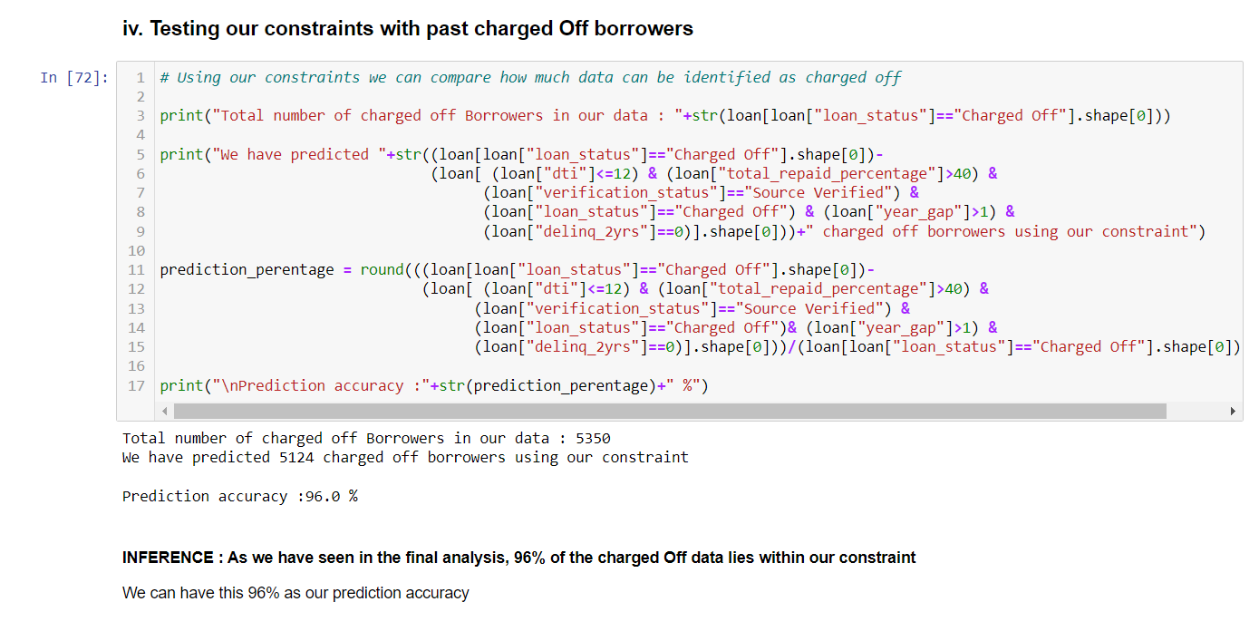
Accuracy of our constraint
The existing data has totally 5, 350 charged off borrowers
Using our constraint we predicted 5, 054 of the borrowers out of these which in turn gives us 96% prediction accuracy.
Let’s take a look on the analysis we made (reference jupyter notebook cell #72)

Slide 31
Conclusion
The variables dti, total_repaid_percentage , verification_status , home_ownership , last_pymnt_year are three major parameters that can be used to predict the loan defaulter at the maximum of 96% accuracy.
Of course only these variables can't be the major parameter of loan defaulters every time . As we see our data, the loan issue rate went peak in 2011, the reason for this is " 2011 US Debt Ceiling Crisis " . It affected many of the people's financial status which lead them to borrow.
The major influencer variable might be a different one other year, but these five driver variables which we have selected is going to be there all time. Thus we conclude that, our data-driven analysis will definitely help to spot the loan-defaulters.

Slide 32

Slide 11
THANK YOU

